Slide 1
Skill Migration
Visualization of Complex Data
Group 3: Anuradha Tidke, Yanjun Liu, Zheyue Wang, Meron Samuel Metaferia
Fall 2021

Slide 2
Agenda
Introduction
Objectives and Goals
Dataset
Questions and Discussion
Question 1
Question 2
Question 3
Question 4
Conclusion

Slide 3
Introduction
Skilled Migration
In migration studies scholarship, highly skilled migration refers generally to the stream of migrant, i.e. foreign workers sharing specific characteristics and who therefore qualify for a particular visa category. (Weinar, et al.)
Benefits
Destination
migrants contribute more in taxes and social contributions than they receive in benefits
migrants fill important niches both in fast-growing and declining sectors of the economy
migration boosts the working-age population (median age 20-30)
Source
Remittances from citizens abroad boosts the country’s economy
Transfer skill, new technology, democratic ideas, and can alleviate labor market pressures in their country of origin, since skilled workers are usually underemployed or unemployed in their country of origin
Notes:
Meron
Skilled migration when structured properly can benefit both the source and destination countries
https://www.un.org/press/en/2010/gaef3291.doc.htm
https://www.oecd.org/migration/OECD%20Migration%20Policy%20Debates%20Numero%202.pdf

Slide 4
Cont’d
World Bank Group and Linkedin partnered to use linkedin’s data 2015-2019
Beneficial for policy makers and researchers in both source and destination country
Insights into quickly changing labor market
What skills are acquired or lost in my country as a result of talent migration?
What are the most recent sectoral employment trends, and which skills are most relevant to them?
Leaders
Benchmark and compare labor market trends
Real-time policy adjustments

Slide 5

Quick Facts
~9 million Americans employed at immigrant-owned firms
262 jobs created for every 100 international grads working in STEM fields
50% of billion dollar valued startups have an immigrant founder
https://gulfnews.com/living-in-uae/relocate/here-is-how-you-can-find-the-right-agent-for-immigration-to-us-uk-canada-or-australia-from-the-uae-1.1580224340600

Slide 6
Motivation and Goals
Understand how different skill groups are progressing based on skill, industry type, occupation, and migration (from a skill group and/or to a country)
Targets of audience
policy makers and researchers
Gives them extensive and dynamic insights into quickly changing labor market
Leaders
Can use it to compare labor markets around the world, study skills, occupations, migration, and sectors
Can use it to make policy adjustments based on real-time data
Students or employment seekers
Provide some references for anyone who would like to learn more about employment abroad

Slide 7
Dataset
Dataset is from the world bank partnership with linkedIn - data
Shows skill migration between 2015-2019
It has 88,035 rows and 9 columns
Features
Country code / Country Name
World Bank Income Classification - country’s income category (low income, upper middle income, high income)
World Bank Region Classification - south asia, middle east, sub-sahara etc
Skill Group Id - unique number for each skill group
Skill Group Category - category based on field of study (eg: tech skills, business, soft, disruptive tech skills)
Skill Group Name - specific name of skill (eg: software testing, airforce, data science)
Net per 10k - net number migration per 10,000 people of a country’s population
Notes:
Yanjun

Slide 8
Questions
What is the distribution of the net value of skill migration from 2015 -2019?
How many positions are needed for the Tech skill set and Disruptive skill set?
How are the migration numbers for the “Data Science” field globally?
Is the migration pattern (inwards or outwards) largely dependent on the income class of the people migrating?

Slide 9
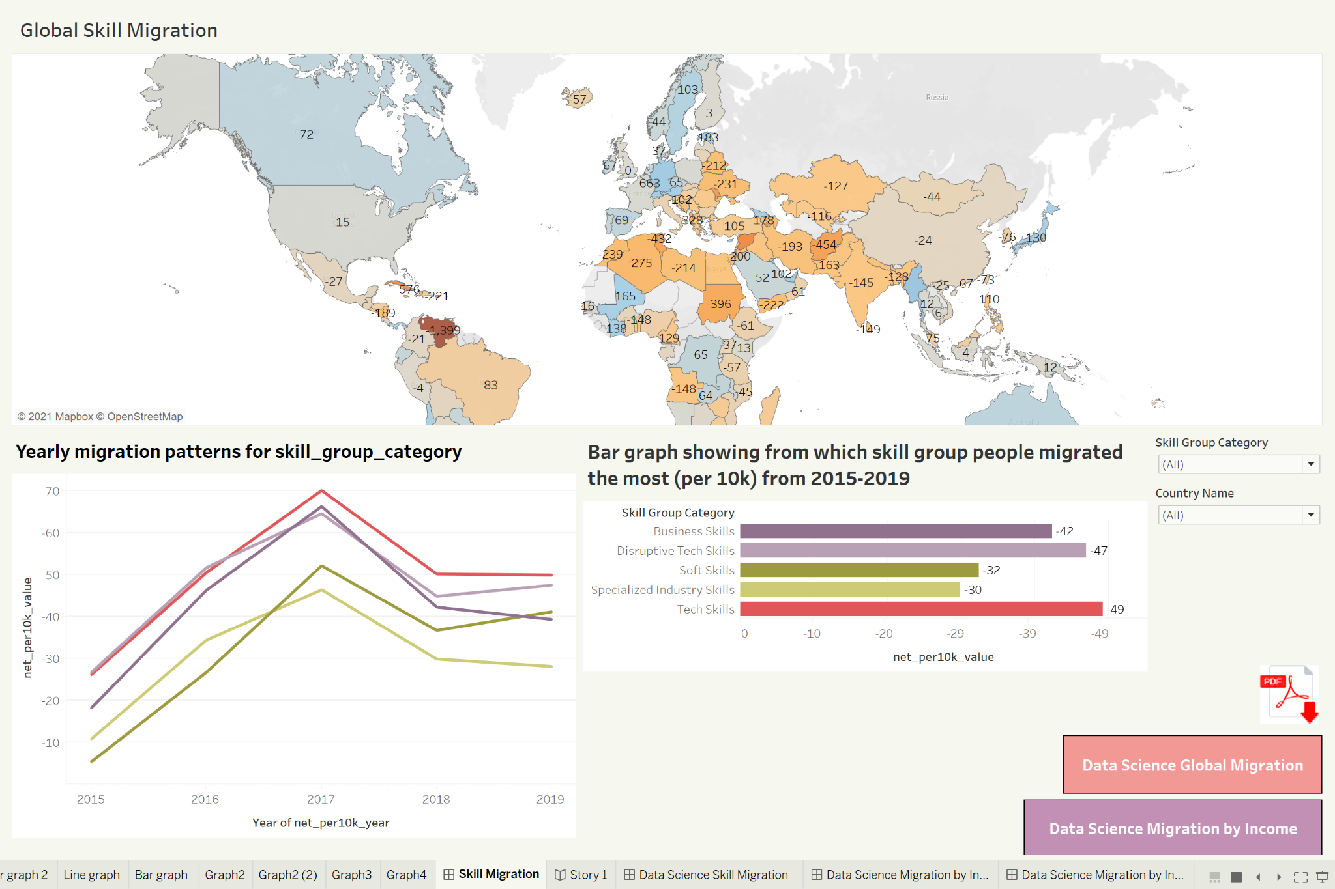
Dashboard
Dashboard-Skilled-Migration

Slide 10
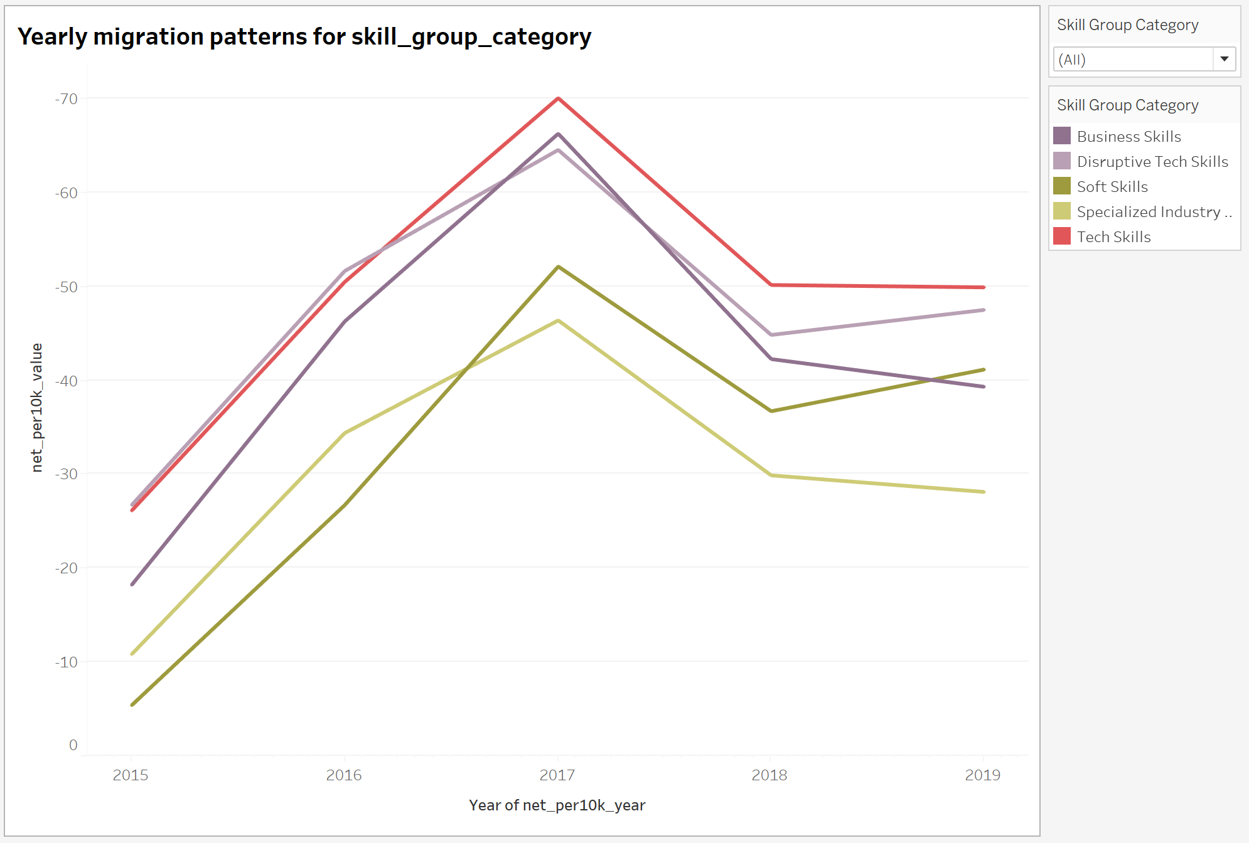
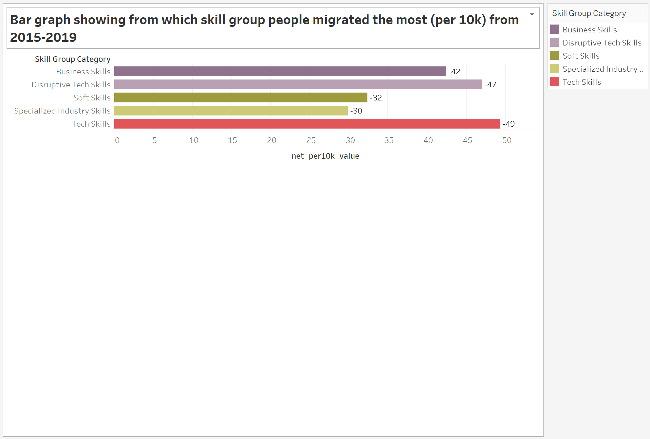
Questions Discussion
What is the distribution of net value of skill migration from 2015 -2019?
Notes:
Anuradha- first two questions

Slide 11
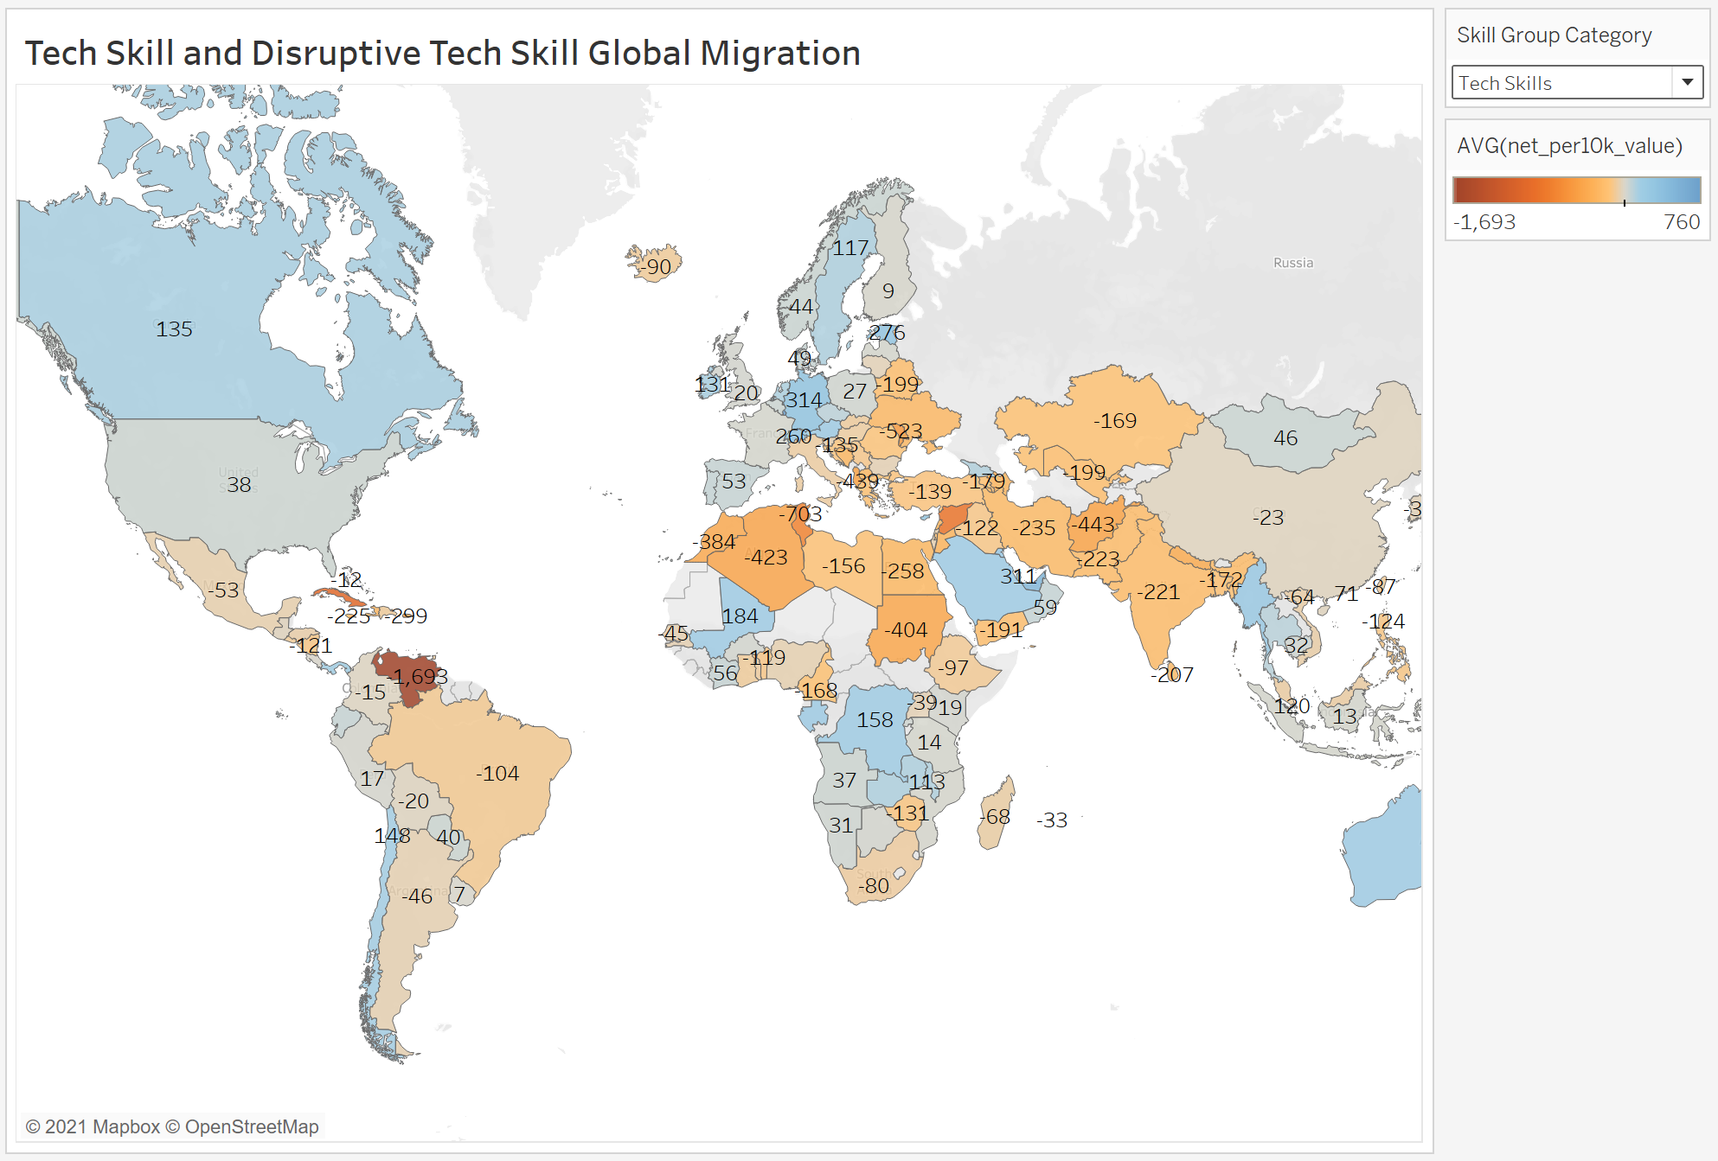
2 . How many positions are needed for the Tech skill set and Disruptive skill set?
Bluer shades represent inward migration.
For example: Canada needs 135 positions per 10k in the Tech skills category
Reddish shaded represent outward migration.
For example, 221 positions/people have migrated from India per 10k, in the Tech skills category

Slide 12
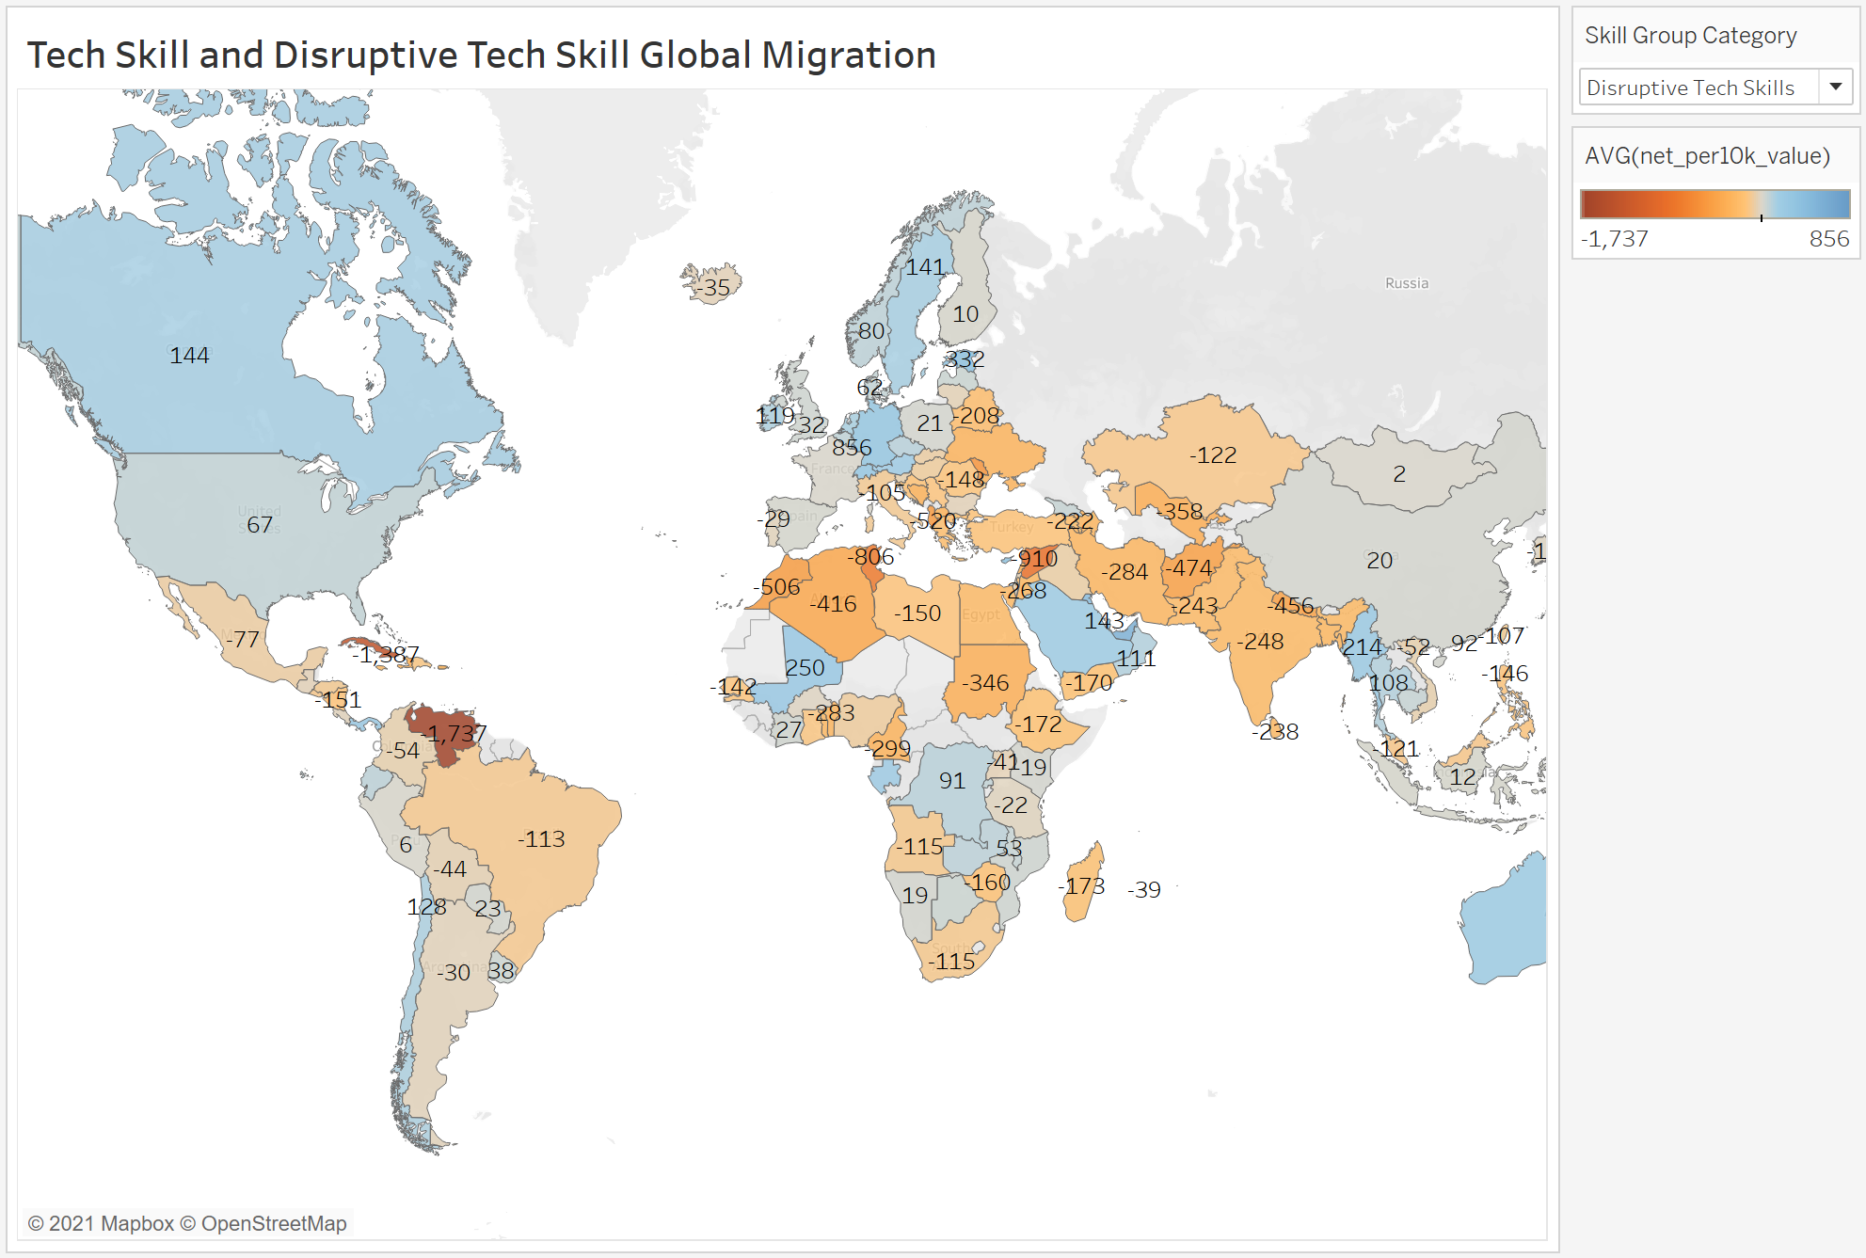
Bluer shades represent inward migration.
For example: Canada needs 44 positions per 10k in the Disruptive Tech skills category.
Reddish shaded represent outward migration.
For example, 248 positions/people have migrated from India per 10k, in the Disruptive Tech skills category

Slide 13
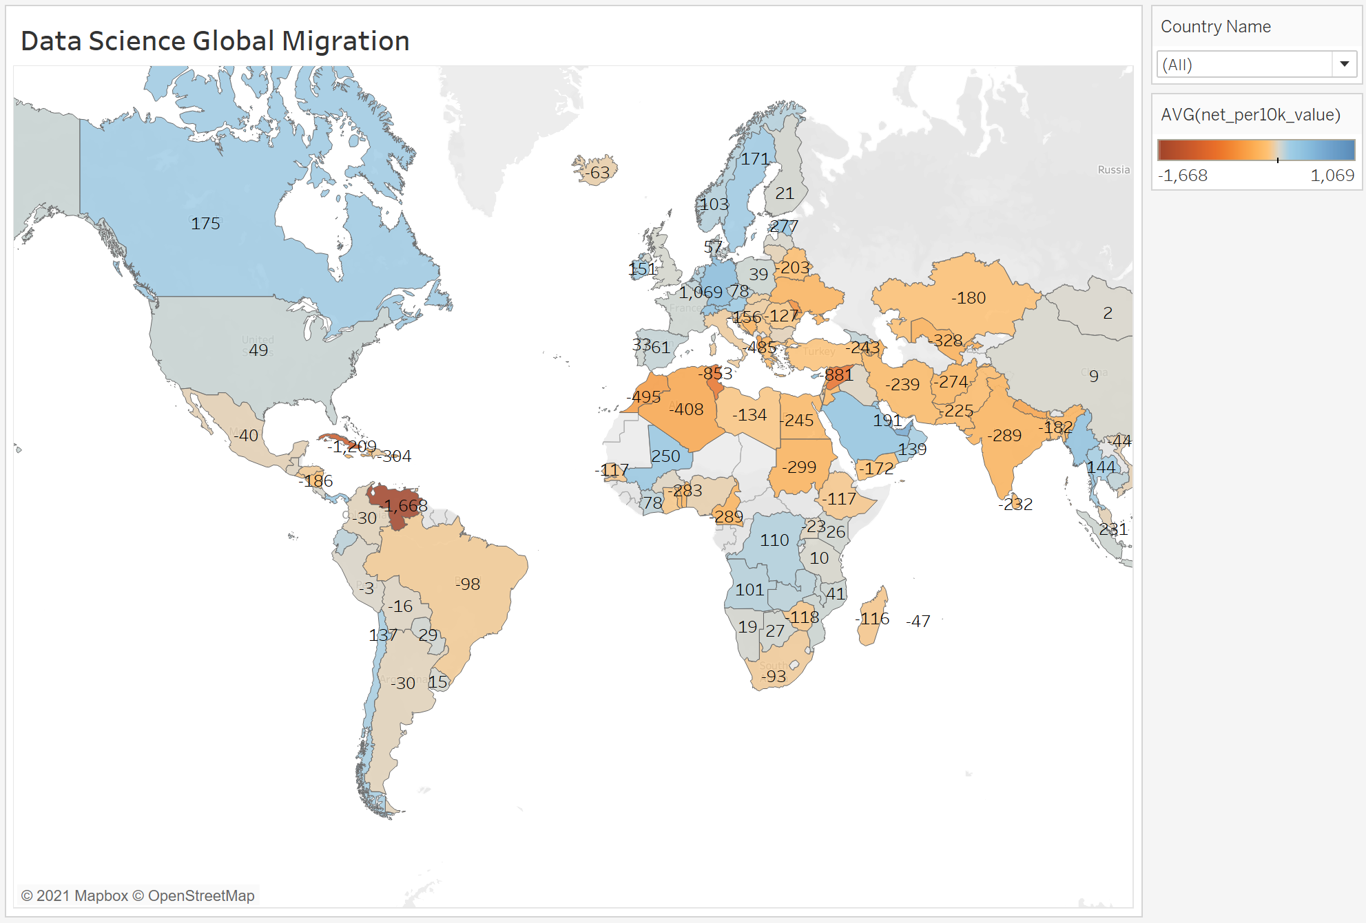
3. How are the migration numbers for the “Data Science” field globally?
For the data science field:
The US needs 49 positions per 10k of migrations.
Canada needs 175 positions
For India, the outward migration is 289 positions/people per 10k migrations

Slide 14
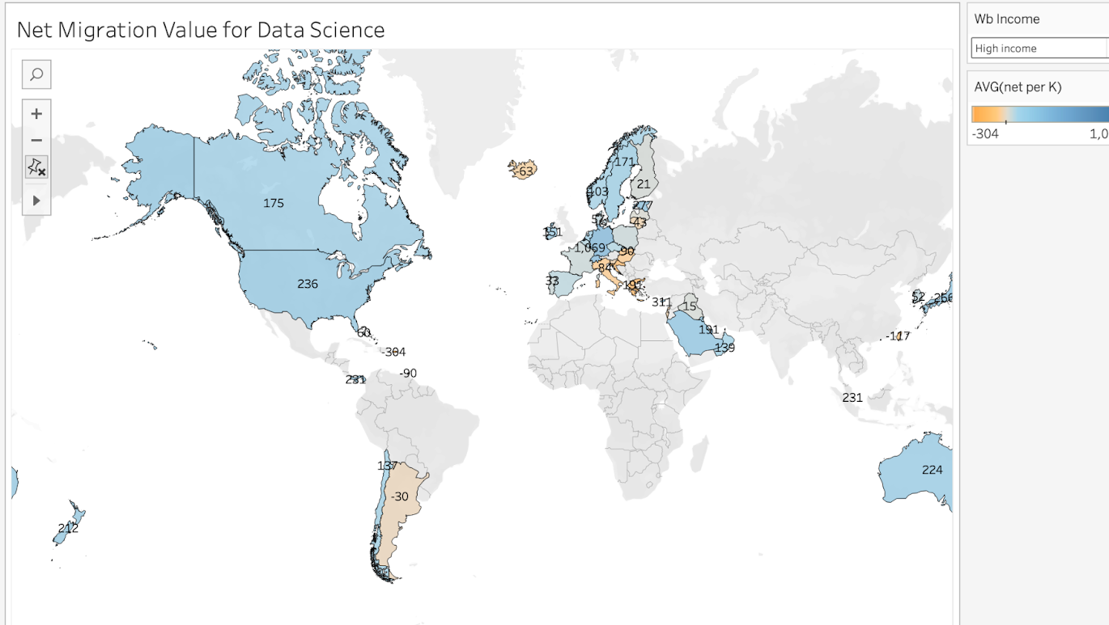
4. Is the migration pattern (inwards or outwards) largely dependent on the income class of the people migrating?
High income:
For the graph shown beside, we can see that developed countries such as U.S, Canada, and Australia have large amount talent come in.
Countries or regions with high incomes will attract more high-quality talents and increase the inflow of talents. And vice versa.

Slide 15
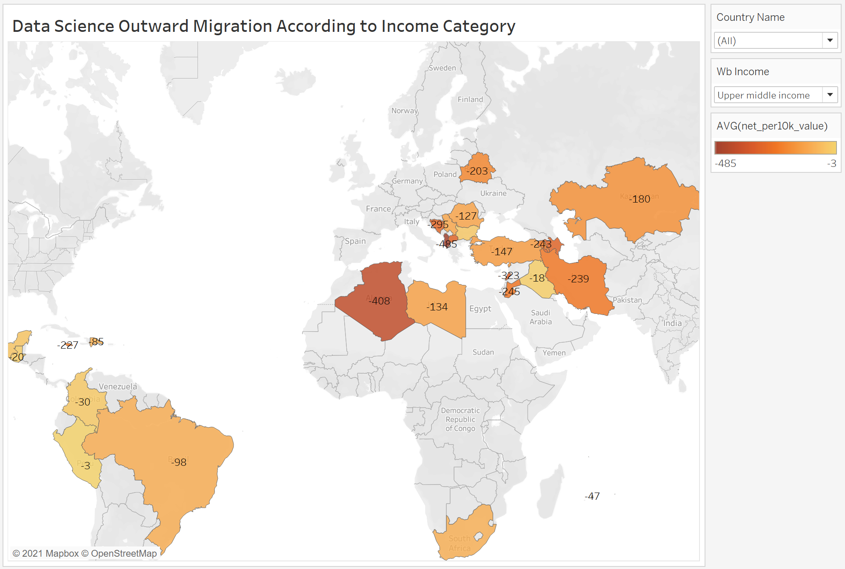
Upper middle income class:
The above observation is helpful in deciding policies for the migrating income category people. For example, the governments of India and Sudan will focus on creating more jobs in the Data Science field for lower middle income category people.

Slide 16
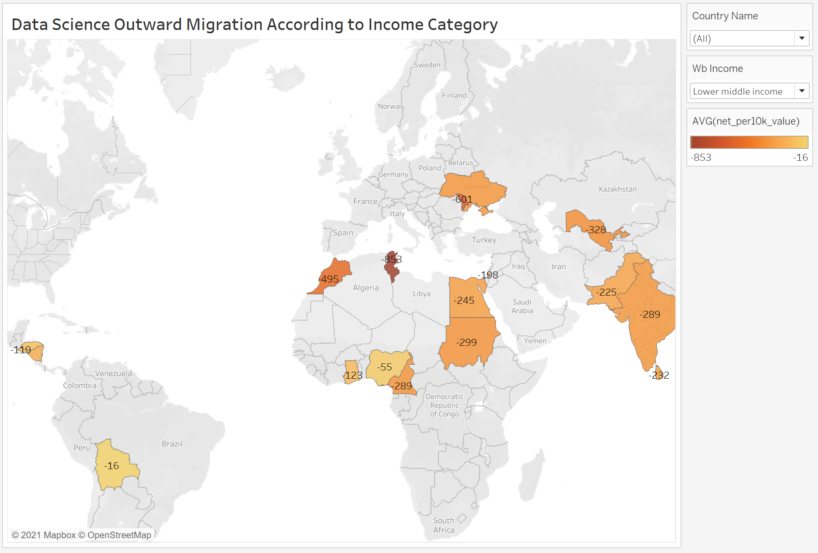
Lower middle income class:
As can be seen, the migration numbers for a country depend on the income class. If we consider lower middle income category migrations, higher numbers are seen in countries like India, Sudan, Morocco, etc. But we don’t see any migration in the upper middle income category from these countries. Migrations in this income class are majorly from countries like Iran, Algeria, Turkey, Brazil etc

Slide 17
Conclusions
Migration has been increasing from 2015 to 2019, with a peak of skilled migrants in 2017
Migration has declined in 2019 mainly due to covid pandemic
Tech skill migrants took the lumpshare of migrants in all regions for all the years
US and Canada have the highest positions in tech and disruptive tech skills
US and Canada also have the highest positions and migrants in the field of data science
Migrant rate is dependent upon a country’s income classification

Slide 18
References
Weinar, A. and Klekowski von Koppenfels, A., 2020. Highly Skilled Migration: Concept and Definitions. [online] SpringerLink. Available at: <https://link.springer.com/chapter/10.1007/978-3-030-42204-2_2> [Accessed 19 November 2021].
Juni Zhu, T., Fritzler, A. and Orlowski, J., n.d. Data Insights: JOBS, SKILLS AND MIGRATION TRENDS METHODOLOGY & VALIDATION RESULTS. [online] Documents1.worldbank.org. Available at: <https://documents1.worldbank.org/curated/en/827991542143093021/pdf/World-Bank-Group-LinkedIn-Data-Insights-Jobs-Skills-and-Migration-Trends-Methodology-and-Validation-Results.pdf> [Accessed 19 November 2021].
Clemens, M., 2013. What Do We Know About Skilled Migration and Development? [online] Migrationpolicy.org. Available at: <https://www.migrationpolicy.org/pubs/SkilledMigration-Development.pdf> [Accessed 19 November 2021].
Celasun, O., Milesi-Ferretti, G. and Obstfeld, M., 2017. The Year in Review: Global Economy in 5 Charts. [online] IMFBlog. Available at: <https://blogs.imf.org/2017/12/17/the-year-in-review-global-economy-in-5-charts/> [Accessed 4 December 2021].

Slide 19

Questions
https://www.google.com/url?sa=i&url=https%3A%2F%2Fstrengthrunning.com%2F2011%2F10%2Fquestions-every-runner-should-be-able-to-answer%2F&psig=AOvVaw2u5NQFMAn40_lLFVgcDgTM&ust=1638981478420000&source=images&cd=vfe&ved=0CAsQjRxqFwoTCJjw3IGQ0vQCFQAAAAAdAAAAABAD

